Slide 1

Text-driven Image Style Transfer:
Achieving Visual Manipulation through Stable diffusion, PTP, and NTI
Zhang Xiting, Guo Jiawei,
Wang Xiaoye, Lu Siyuan
2026.5.5

Slide 2
CONTENT
01
Background & Significance
02
Framework
03
Methods
04
Results

Slide 3

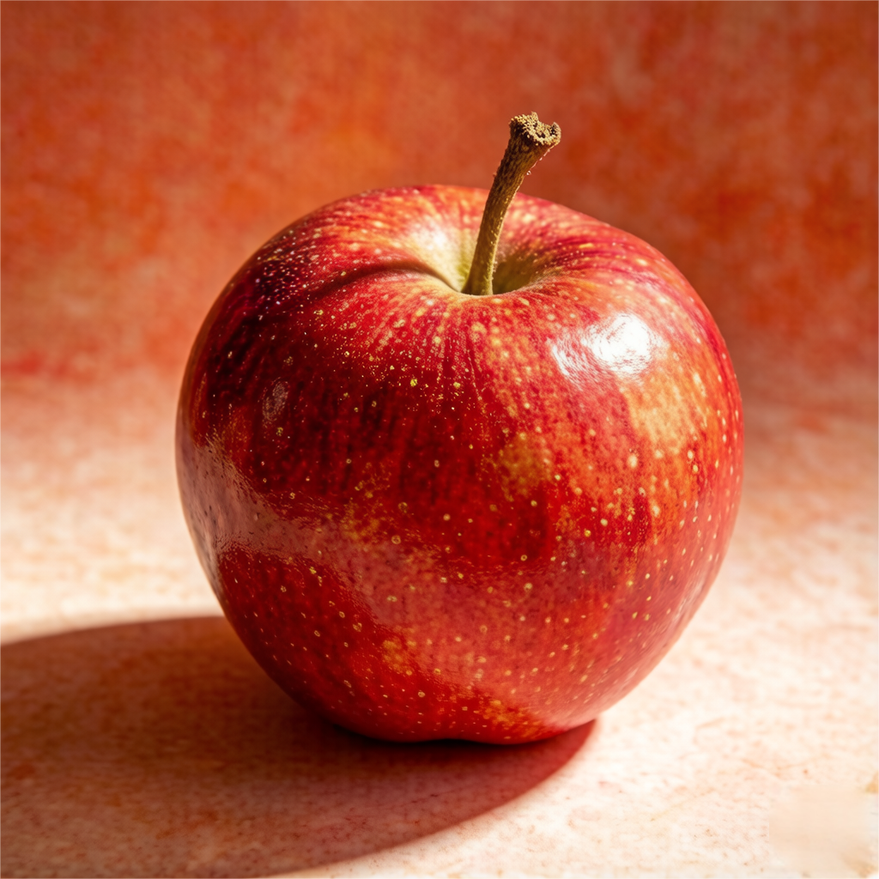
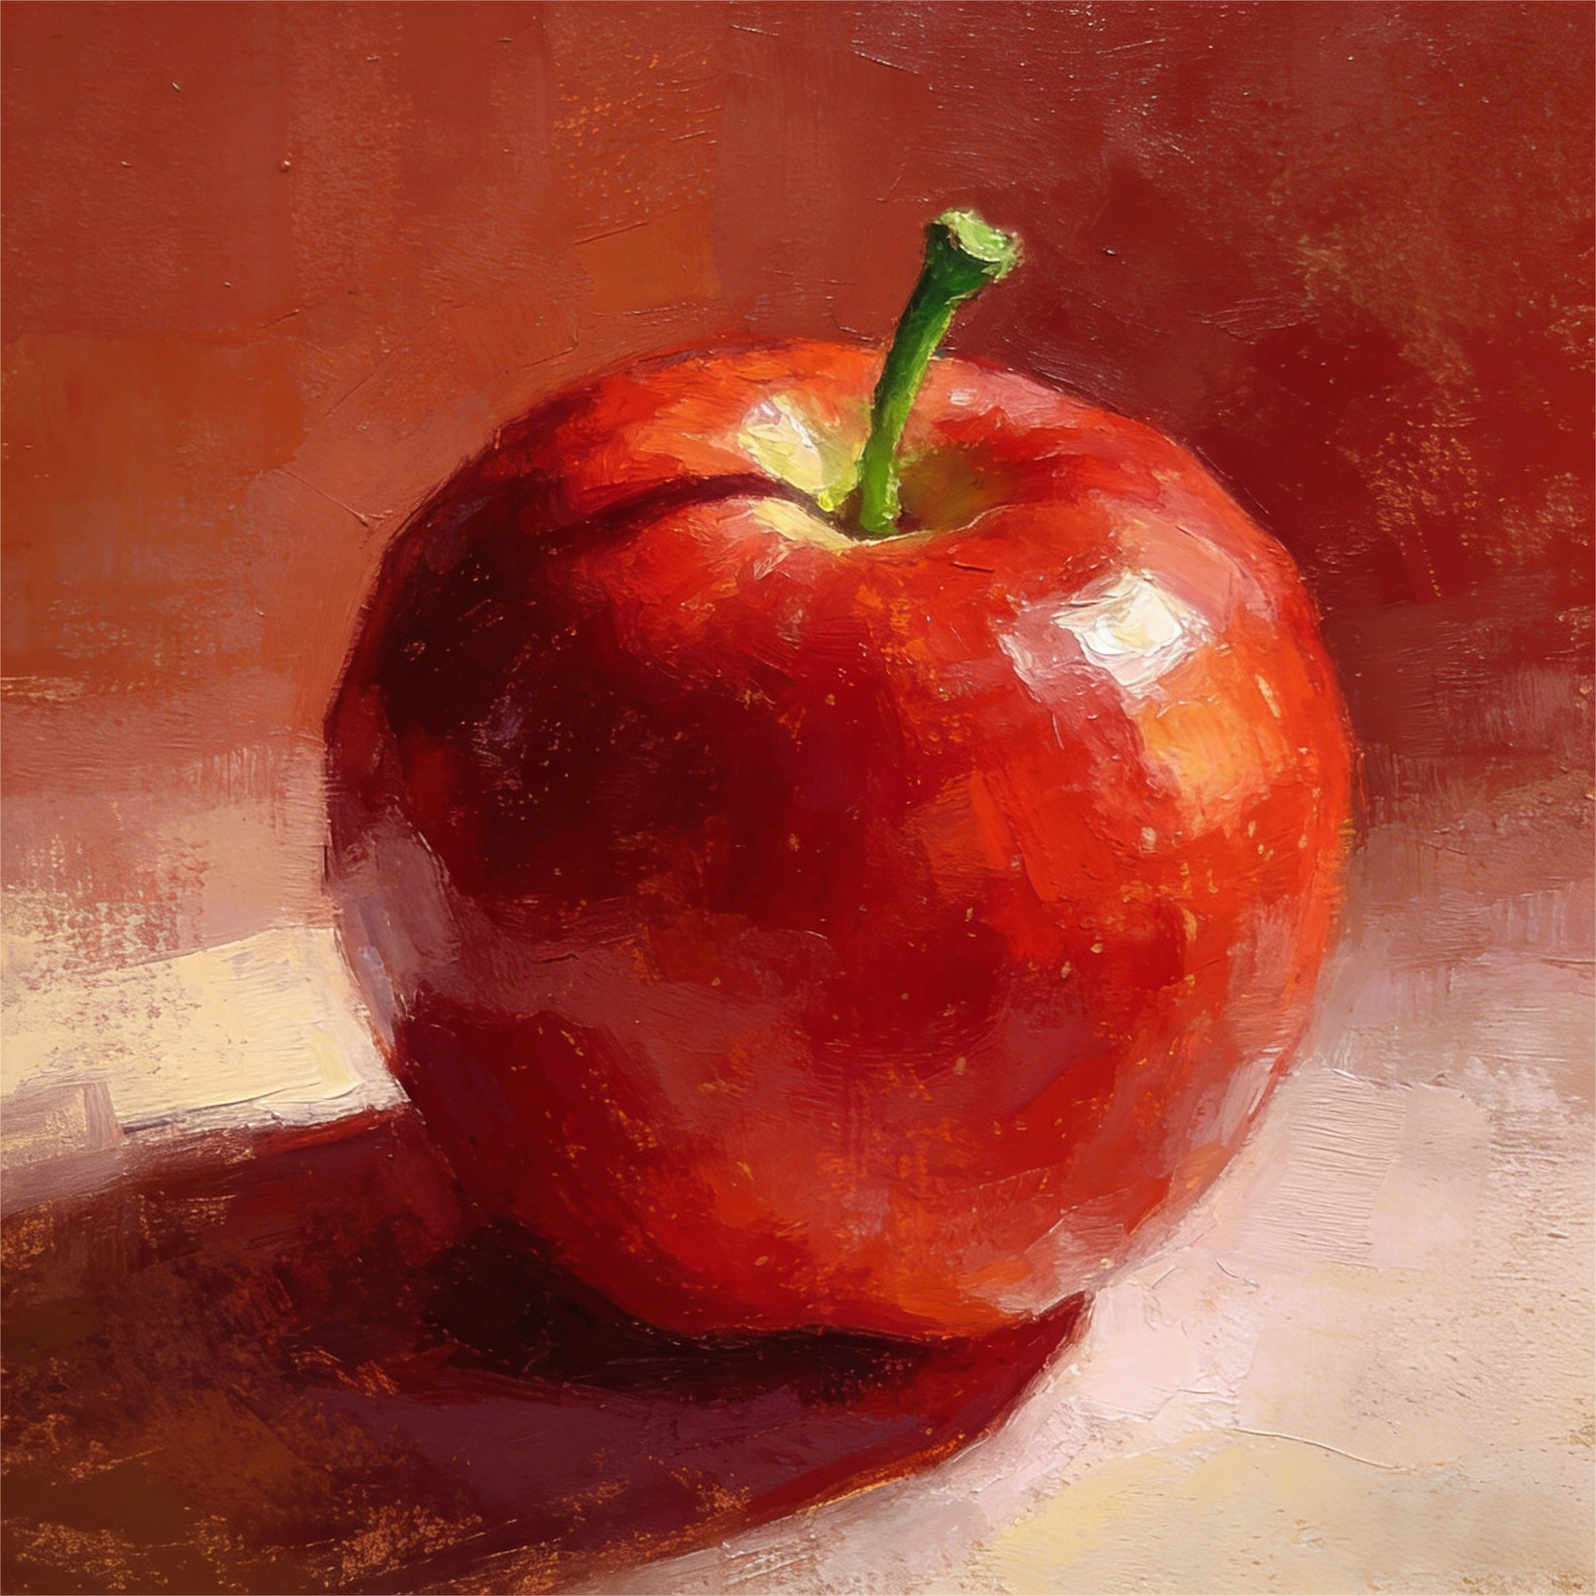
Background
& Significance
Framework
Methods
Results
Significance:
This research contributes significantly by:
1. Offering a novel solution for controlled image editing, which can be applied in various fields including digital art, advertising, and personalized content creation.
2. Providing a robust framework for future innovations in text-driven image editing.
In recent years, the advancements in generative models like Stable Diffusion have revolutionized how we create images based on textual descriptions.
Current Limitations:
Fail to maintain the original structure and details.
💬
“Turn this picture into an oil painting style.”
Input
Output

Slide 4
Background
& Significance
Framework
Methods
Results
Input image
DDIM Inversion
点击输入内容
点击输入内容
Attention mechanism
Diffusion generation
Stylized image results
Latent Code
Null-text Inversion
Text Prompt
Prompt to Prompt
Partial editing

Slide 5
Background
& Significance
Methods
Methods
Results
Framework
01
Null Text Inversion
Methods
02
Prompt - to - Prompt
Attention Storage Mechanism
Local Editing and Style Intensity Control
03

Slide 6
01
Null-Text Inversion
Notes:
In this project, we directly use the StableDiffusion Model without retraining or modifying the weights, achieving results only through interception and replacement.
Previously, my two teammates have explained the Null-Text Inversion concept, which ensures the original image can be replicated during generation, as well as the Prompt-to-Prompt concept, which intercepts the original attention data of the model and replaces it with the desired attention data to achieve "Modifying only the style, not the structure.“
Next, I will describe how local editing and style intensity control are implemented throughout the entire process.

Slide 7
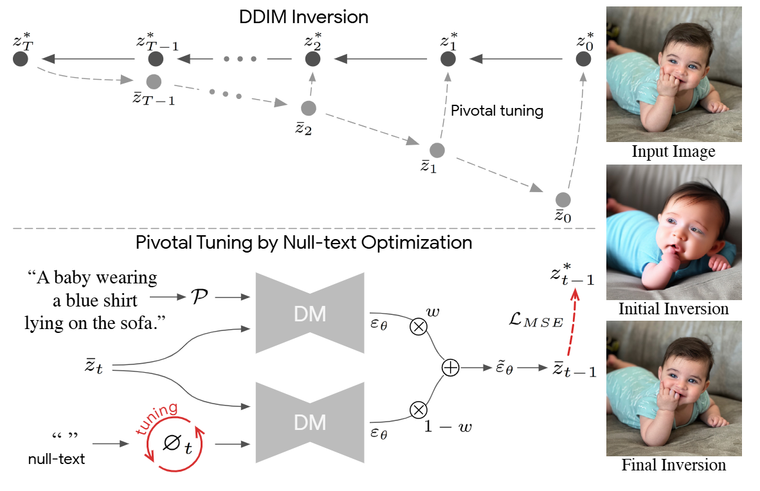
NTI
Null-text Inversion
Null-text Inversion is an image reconstruction and text-driven editing method. It embeds real images into the latent space of diffusion models through two key steps: pivotal inversion and null-text optimization, enabling high-fidelity reconstruction and text-driven editing.
Two Core of Null-text Inversion——Pivotal Inversion and Null-text Optimization
Pivotal Inversion:The initial trajectory obtained by DDIM inversion is used as the "hub", and the optimization around it is carried out to gradually approach the original image coding, avoiding random noise initialization, improving efficiency and editability.
Null-text Optimization:Only the null-text embedding is optimized, while the model weights and conditional embedding remain unchanged, thereby preserving the model's editing capabilities.
Notes:
我们已经了解了PtP，但它只能在生成的图像上工作，那么，我们该如何将这项技术应用于真实照片呢？这时就需要运用“零文本反转”（Null-text Inversion，简称 NTI）技术了。我们首先来回忆一下什么是NTI，它是一种图像重建和文本驱动的编辑方法，它把真实图像嵌入扩散模型的潜空间中。主要靠两个核心步骤：Pivotal Inversion（关键点反演） 和 Null-text Optimization（空文本优化）。第一步，Pivotal Inversion。先用 DDIM 反演得到一条初始轨迹，把它当作“枢纽”，围绕它进行优化。这样能避免随机噪声，同时提高效率。第二步，Null-text Optimization。只优化空文本嵌入，也就是无条件嵌入，不动模型权重和条件嵌入，从而保留模型的编辑能力。

Slide 8
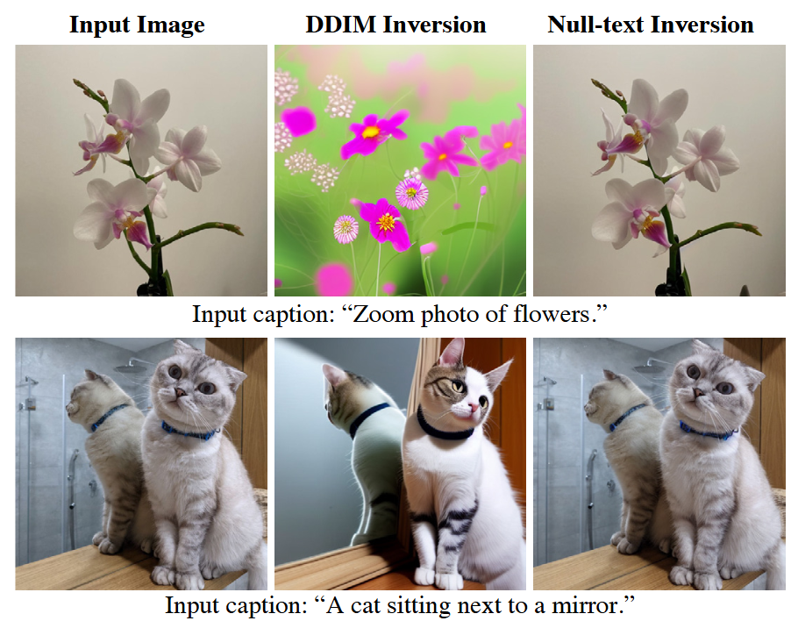
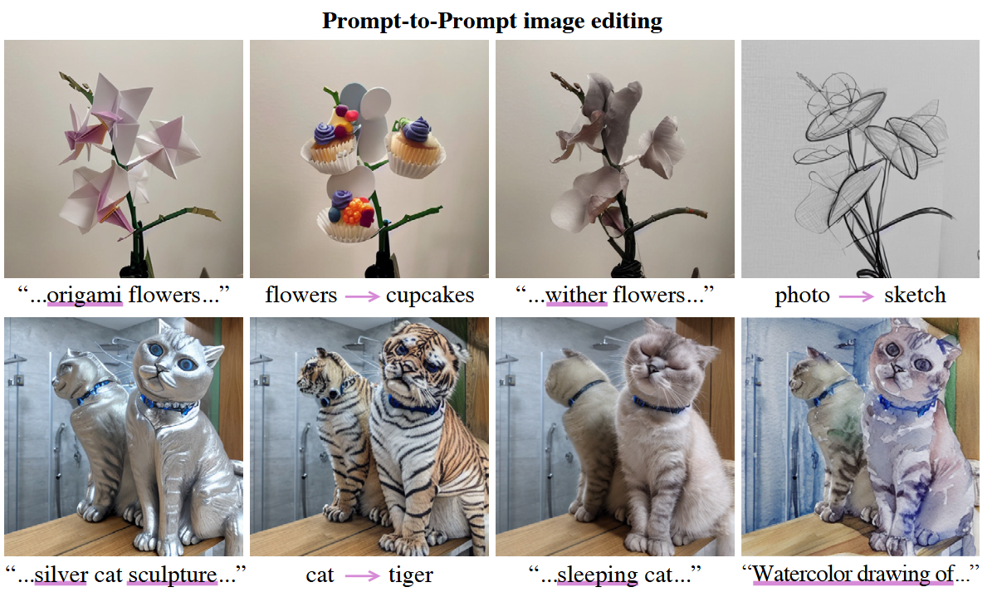
NTI
Core Capabilities of NTI
The core contribution of NTI lies in being the first method that enables the Prompt-to-Prompt technique to be applied to real image editing. Through pivotal inversion and null-text optimization, NTI achieves intuitive text-driven modifications while maintaining high fidelity. Its specific capabilities include:
● High-fidelity Reconstruction
By optimizing the null-text embedding, NTI can almost perfectly reconstruct the input real image, avoiding the distortions of traditional DDIM inversion under high guidance scales.
● Text-guided Editing
After completing the inversion, the user only needs to modify the prompt to perform editing. For example,：
“cat → tiger” （Object Swap）
“photo → sketch” （Style Change）
“flowers → cupcakes” （Semantic Replacement）
● Multiple Edits
The optimized embedding obtained after a single inversion can be reused, supporting multiple different Prompt-to-Prompt edits on the same image without the need for retraining or fine-tuning the model.
Notes:
NTI 最大的贡献，是它第一次让 Prompt-to-Prompt 这种编辑方法真正用在真实图片上。它有三个核心能力：
高保真重建——几乎完美还原输入图像，避免传统 DDIM 反演的失真。
文本驱动的编辑——改一下 prompt 就行，比如猫变老虎、照片变素描、花朵变纸杯蛋糕。
多次编辑——一次反演的结果可以重复用，换不同的 prompt 做多种编辑，不用重新训练模型。

Slide 9
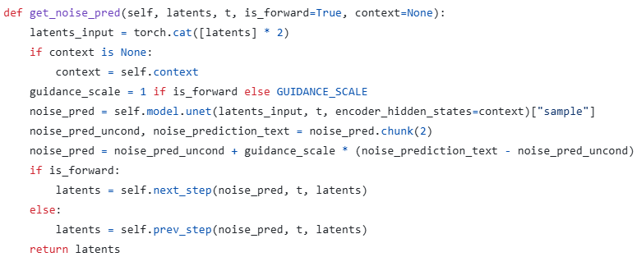
NTI
Core Mechanisms and Key Auxiliary Functions of NTI
The editing process is divided into two core stages:
DDIM Inversion: Encodes the real image into a noise trajectory.
Null-text Optimization: Optimizes the null-text embedding to achieve high-fidelity reconstruction.
Key auxiliary function: CFG (Classifier-Free Guidance) noise prediction — get_noise_pred
Key point:
Duplicate the input latent, and pass in both the conditional embedding and the unconditional embedding simultaneously.
Forward (DDIM inversion): guidance_scale=1, without CFG.
Reverse (editing generation): guidance_scale=7.5, CFG enabled.
CFG formula: pred = uncond + w× (cond - uncond)
Notes:
代码的整个流程可以分为两步：第一步是DDIM Inversion——也叫关键反演，将真实图像编码为潜变量，然后通过确定的DDIM正向加噪过程，逐步演化到纯噪声，同时保存每一步的潜变量，形成一条“可逆轨迹”。第二步是Null-text Optimization——空文本优化，这是NTI的核心，它沿着去噪方向，在每个时间步优化一个空文本嵌入，使得带CFG的去噪步骤能够重建DDIM反演中对应的潜变量，从而修正CFG带来的轨迹偏离。
我们先补充讲解一个重要的辅助函数——get_noise_pred。这个函数是CFG噪声预测的核心实现，在DDIM反演和编辑生成两个阶段都会被调用。
函数的巧妙之处在于：把输入潜变量复制一份，和上下文（条件嵌入+无条件嵌入）一起送入UNet，一次前向传播就同时得到了条件噪声预测和无条件噪声预测，效率很高。
然后根据 is_forward 参数决定行为：正向时 guidance_scale=1，相当于只用条件噪声预测，保证DDIM反演的确定性；反向时 guidance_scale=7.5，启用完整的CFG引导，增强生成质量。CFG噪声预测的公式是：无条件预测加上引导比例乘以条件预测减去无条件预测的差。
最后根据方向，分别调用 next_step（正向加噪）或 prev_step（反向去噪），完成扩散。

Slide 10
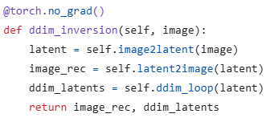
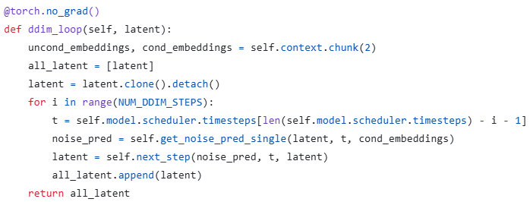
NTI
DDIM Inversion — Obtaining the Latent Trajectory
Why perform DDIM Inversion?
DDIM inversion is performed without CFG, making the trajectory deterministic and invertible.
It provides an “anchor trajectory” for the subsequent null-text optimization.
Notes:
我们来看DDIM Inversion，也就是关键反演。这里需要先理解一个核心矛盾：DDIM反演时模型只用有条件嵌入，没有CFG，所以轨迹是确定且可逆的。但后续编辑生图时为了质量必须开启CFG，这就导致两条轨迹分叉。DDIM反演的目的就是先生成一条干净的、确定性的“锚点轨迹”，供后续优化使用。
来看代码。ddim_inversion 是入口方法，它做了三件事：首先把图像通过VAE编码器变成潜变量；然后验证VAE重建质量；最后调用 ddim_loop 执行反演循环，返回完整的潜变量轨迹。
ddim_loop 是核心循环，它把上下文拆分成无条件嵌入和条件嵌入两份，但循环中只用 cond_embeddings 来预测噪声，不涉及CFG。每一步都通过UNet预测噪声，然后执行DDIM正向加噪，并将当前步的潜变量追加到 all_latent 列表。循环结束后得到一个的完整轨迹。这个轨迹就是后续优化的“锚点”。

Slide 11
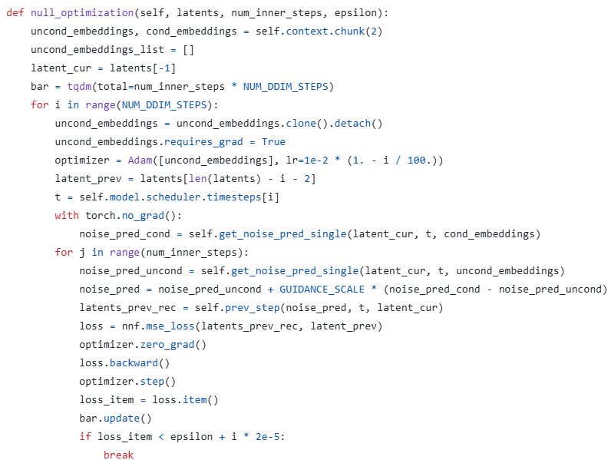
NTI
Null-Text Optimization — Core Optimization Algorithm
Core idea: Learn a dedicated null-text embedding for each denoising timestep, so that a single denoising step with CFG can accurately reconstruct the corresponding latent code from the DDIM inversion.
Notes:
Null-text Optimization是整个NTI最核心的算法。对于DDIM反演得到的轨迹中每一对相邻的潜变量，我们要找一个特殊的空文本嵌入，使得用这个嵌入做带CFG的去噪时，得到的潜变量能和反演轨迹中的目标潜变量完全对齐。
我们的代码逻辑就是外层循环遍历50个时间步，从纯噪声出发逐步去噪。每个时间步开始时，把无条件嵌入复制一份并设置 requires_grad=True，然后创建Adam优化器，学习率随步数递减。latent_prev 是从反演轨迹中取出的目标潜变量——也就是我们希望当前步去噪后能达到的答案。内层循环是最关键的优化部分。首先在 torch.no_grad() 下计算条件噪声预测，这是不参与梯度更新的。然后在内层循环中计算无条件噪声预测。两者合并得到带CFG引导的噪声预测，再通过 prev_step 得到重建的上一时刻潜变量。最后用MSE损失将重建结果与锚点目标进行比较，反向传播更新无条件嵌入。
这个过程在每个时间步重复，直到损失小于阈值。优化完成后，该步的嵌入被保存到列表中，同时用优化好的嵌入执行一次真正的去噪步，得到下一个潜变量。最终返回的是所有时间步优化后的空文本嵌入列表。
这样，我们就得到了可以用于编辑的纯噪声和嵌入列表。

Slide 12
02
Prompt to Prompt
Notes:
In this project, we directly use the StableDiffusion Model without retraining or modifying the weights, achieving results only through interception and replacement.
Previously, my two teammates have explained the Null-Text Inversion concept, which ensures the original image can be replicated during generation, as well as the Prompt-to-Prompt concept, which intercepts the original attention data of the model and replaces it with the desired attention data to achieve "Modifying only the style, not the structure.“
Next, I will describe how local editing and style intensity control are implemented throughout the entire process.

Slide 13
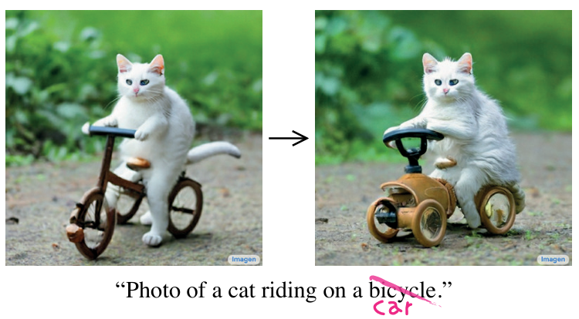
P2P
Prompt-to-Prompt
Objective
The goal is simple: we want to edit a generated image only by changing the prompt. We must keep the spatial structure of the original image exactly the same, and only change the semantic content.
For example, if we change ‘a bicycle' to ‘a car,' the car should stay in the same position as the bicycle. The pose, background, and composition should not change."
Notes:
Hello everyone. Today I will introduce Prompt-to-Prompt, or P2P. It is an image editing technology by Google.
Its goal is very simple: we want to edit a generated image by changing text prompts. At the same time, we keep the spatial structure completely unchanged, and only change the semantic content.
For example, if I change the word "bicycle" to "car" in the prompt, the car should appear in the exact same position as the bicycle. The pose, background, and layout should not change. This is what P2P wants to do.

Slide 14
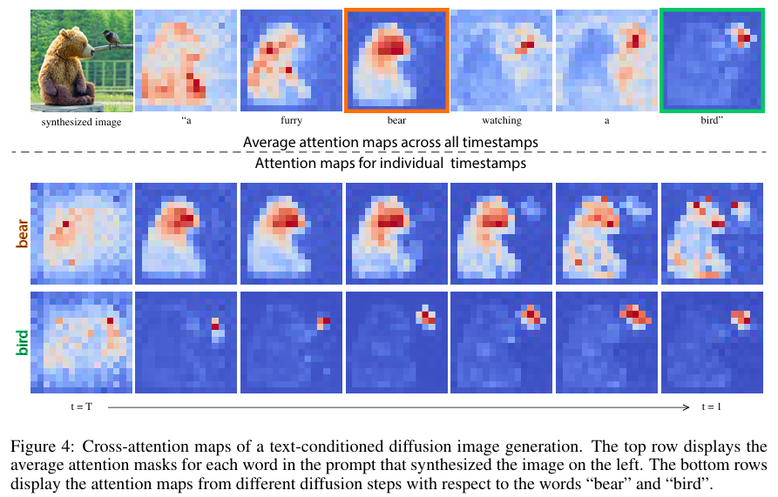
P2P
1. Key Discovery of Prompt-to-Prompt
Core Discovery
The Cross-Attention Maps control the spatial layout and geometry of the generated image.
Token Attention Map
Text and image features fuse at each diffusion step via Cross-Attention Layer.
Each text token generates a Spatial Attention Map (like a heatmap) within the cross-attention layers.
Case Study: Bear and Bird
  — The map for 'bear’ token highlights the area of the bear.
  — The 'bird’ token precisely corresponds to the bird's specific area.
  — Different tokens show high spatial distinctness.
Early Structural Lock-in
The image's spatial structure is determined by attention maps during the early steps of the diffusion process.
Conclusion
The attention map $M$ acts as the bridge between text semantics and spatial structure; Controlling the attention map means controlling the image structural skeleton.
Notes:
So How does P2P do this?
Well, It relies on a key finding: the Cross-Attention Map controls the spatial layout and geometry of the image.
In every step of the Diffusion Model, text features and image features mix in the Cross-Attention layer.
Each text token makes a spatial attention map. It acts like a heatmap. It tells the model "which area this token belongs to, and which pixels it affects".
Look at the picture on the right. The attention map of the token "bear" exactly highlights the bear. "Bird" corresponds to the bird's area. They are highly separate in space.
More importantly: the spatial structure of the image is already fixed by the attention maps in the early steps of the diffusion process.
So, the conclusion is: Attention Map is the bridge between text and structure. Controlling the attention map means controlling the image structural skeleton.

Slide 15
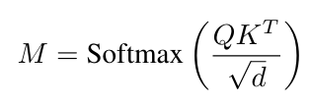
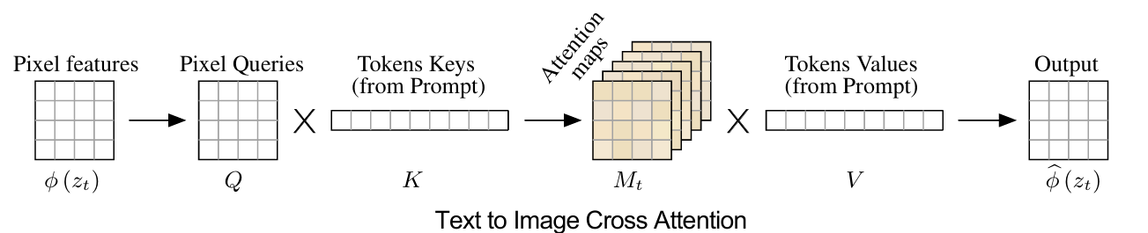
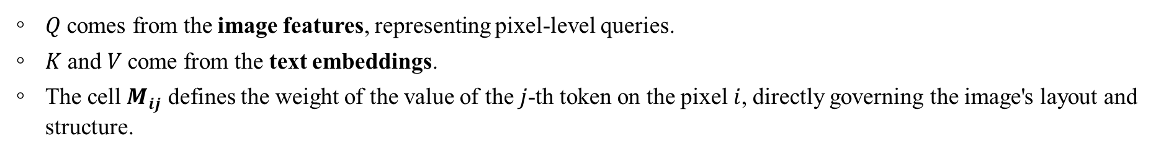
P2P
2. Cross-Attention Mechanism Principle
Attention Maps $M:$
It shows how much each pixel cares about each text token. Because of this, $M$ directly decides the layout and structure of the image.
$Q$ comes from the image features, representing pixel-level queries.
$K$and $V$come from the text embeddings.
The cell $M_{ij}$ defines the weight of the value of the $j$-th token on the pixel $i$, directly governing the image's layout and structure.
Figure: Visual and textual embedding are fused using cross-attention layers that produce spatial attention maps for each textual token.
Conclusion
The Cross-Attention output $MV$ is a weighted average of the text information $V$, using $M$ as the weights. If you control $M$, you control the skeleton of the generated image.
Notes:
Now, let's look at the mathematical foundation.
The formula for Attention Matrix M is Softmax(QKᵀ/√d). Here, Q comes from image features. K and V come from text embeddings.
Each element M_ij means the weight of the j-th token on the i-th pixel. The final output is M multiply V. It is the weighted average of text information V, using M as weights.
This means: M decides "which word" draws "which area". So, the core idea of P2P is...

Slide 16
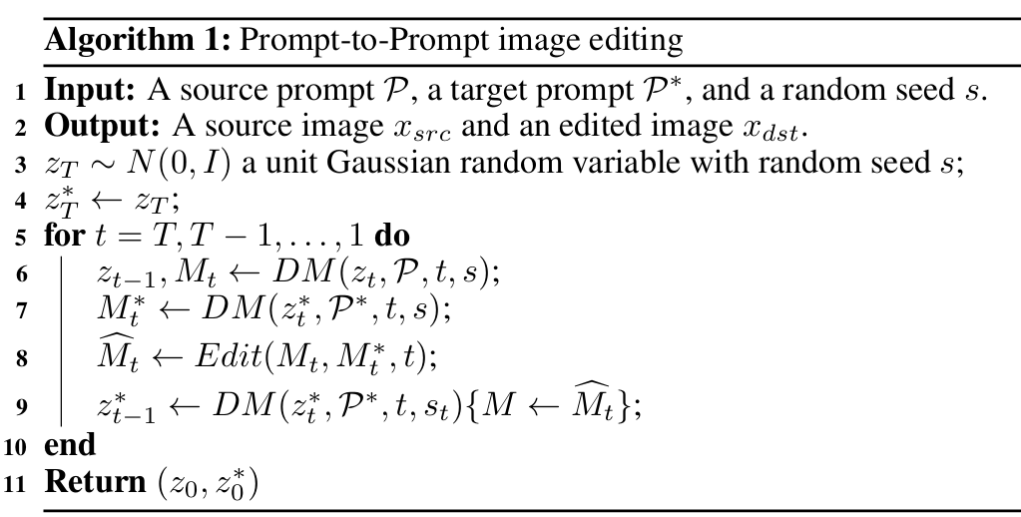

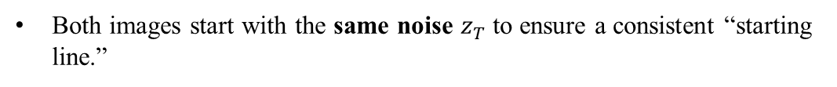
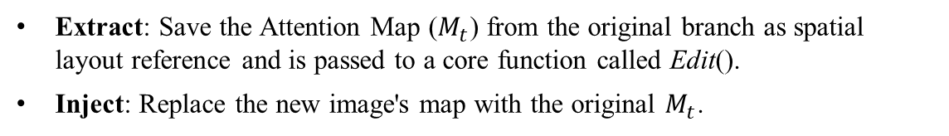
P2P
3. How P2P Works
The Core Concept
We "save" the attention maps from the original image generation process, and then "inject" them into the generation process of the new image, so that the new image inherits the spatial layout of the original image, but with the semantics of the new prompt. It is like telling the model: ‘Please draw a new picture with new words, but use the original layout for every object.’
The method runs two processes for both prompts simultaneously: one for the Source image, one for the Target image.
General Algorithm
  Both images start with the same noise $z_{T}$to ensure a consistent “starting line.”
Extract: Save the Attention Map ($M_{t}$) from the original branch as spatial layout reference and is passed to a core function called Edit().
Inject: Replace the new image's map with the original $M_{t}$.
Output: the noisy image and the attention map
Computation of a single step $t$ of the diffusion process
Edit(), a flexible function that chooses different injection strategies based on the edit type (Replace, Refine, or Re-weight).
The diffusion step where we override the attention map $M$ with an additional given map $\hat{M}$, but keep the values $V$ from the supplied prompt
During the forward process of the target image, we forcibly replace or merge its original attention map with the $M_{t}$ processed by the Edit() function.
$M_{t}^{∗}$ denotes the produced attention map using the edited prompt $P^{∗}$
$Edit(M_{t}, M_{t}^{∗}, t)$ is a general edit function, receiving as input the $t$’ th attention maps of the original and edited images during their generation.
Finally, the new image has the layout of the source, but the semantic content of the target prompt.
Notes:
The core idea of P2P is: We "save" the attention maps from the original image generation process, and then "inject" them into the generation process of the new image, so that the new image inherits the spatial layout of the original image, but with the semantics of the new prompt.
Let's see how it works. We use the same random seed to make two noises. One uses the source prompt P to make the source image. The other uses the target prompt P* to generate the target image.
In each denoising step, we extract the attention map M_t from the source image, while also letting the target branch generate its own attention map M_t* normally.
Then we use an Edit function to combine the two maps, producing a modified attention map M̃_t. We use this new map to overwrite the target branch.
In this way, the target image gets new semantics but keeps the old layout.
The Edit function is very flexible. It supports three strategies: Word Swap, Prompt Refinement, and Attention Reweighting. Next, I will introduce them one by one.

Slide 17
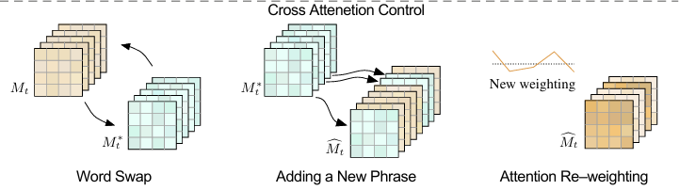
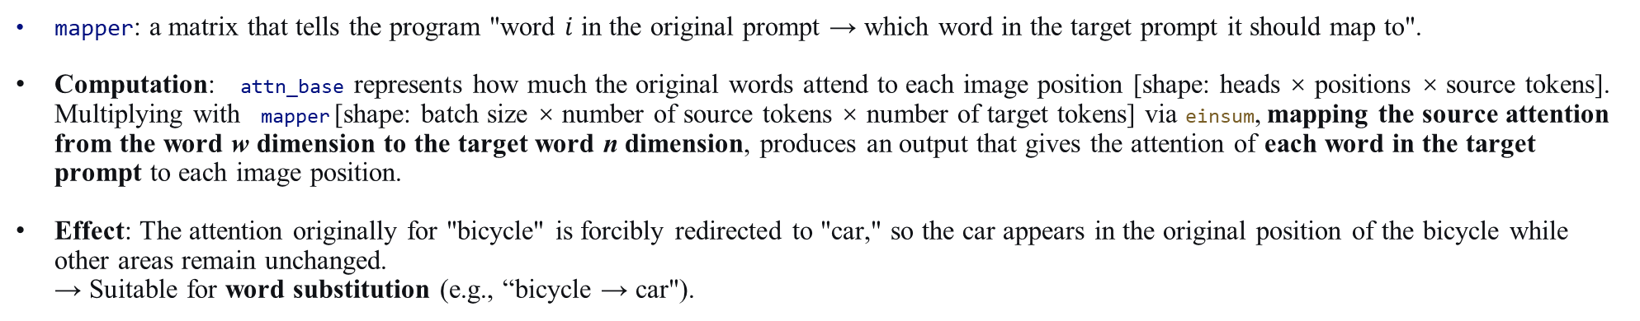
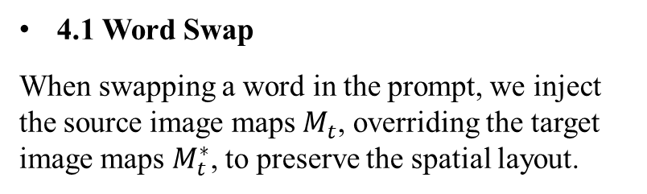
P2P
4. Three Operations/Injection Strategies
4.1 Word Swap
When swapping a word in the prompt, we inject the source image maps $M_{t}$, overriding the target image maps $M_{t}^{∗}$, to preserve the spatial layout.
def replace_cross_attention(self, attn_base, att_replace):
return torch.einsum('hpw,bwn->bhpn', attn_base, self.mapper)
mapper: a matrix that tells the program "word $i$ in the original prompt → which word in the target prompt it should map to".
Computation: attn_base represents how much the original words attend to each image position [shape: heads × positions × source tokens].
Multiplying with mapper [shape: batch size × number of source tokens × number of target tokens] via einsum, mapping the source attention from the word w dimension to the target word n ​​dimension, produces an output that gives the attention of each word in the target prompt to each image position.
Effect: The attention originally for "bicycle" is forcibly redirected to "car," so the car appears in the original position of the bicycle while other areas remain unchanged.
→ Suitable for word substitution (e.g., “bicycle → car").
Notes:
First is Word Swap. We change one word in the prompt to another word.
For example, changing "a cat riding a bicycle" to "a cat riding a car". We want the car to take the exact place of the bicycle.
How to do it?
We define a mapper matrix. It shows which source token matches which target token.
Then we multiply the source attention map by the mapper, and directly overwrite the target attention map.
So, the attention for "bicycle" is forced to move to "car". The car will appear in the old position.

Slide 18
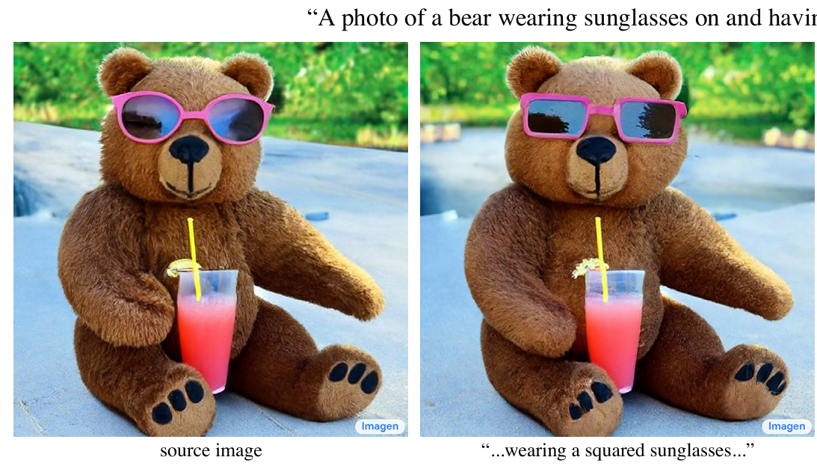
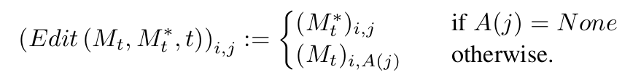
P2P
“A photo of a bear wearing sunglasses on and having a drink.”
4.2 Adding a New Phrase
Inject only the maps that correspond to the unchanged part of the prompt, which enables editing of image details or styles while preserving the original image's spatial layout. The edit function is:
def replace_cross_attention(self, attn_base, att_replace):
attn_base_replace = attn_base[:, :, self.mapper].permute(2, 0, 1, 3)
attn_replace = attn_base_replace * self.alphas + att_replace * (1 - self.alphas)
# attn_replace = attn_replace / attn_replace.sum(-1, keepdims=True)
return attn_replace
For words that appear only in the original prompt and are also retained in the target prompt, we inject the original attention map.
While for newly appearing words, we retain the attention map generated by the target model itself. The two are mixed by a coefficient alphas, which is larger in the early stages of generation to retain more of the original structure, and then gradually decreases to allow the new content to be naturally integrated.
Effect: Smooth transition without abrupt changes → suitable for fine‑tuning details or style transfer.
Notes:
The second operation is Adding a New Phrase, or Prompt Refinement.
For example, the old prompt is "a bear wearing sunglasses". We want to add the word "squared" to make the sunglasses square.
Here, we cannot replace all maps, because the new word has no old match.
The strategy is: for words kept in both prompts, we inject the old attention maps.
For the new word, we keep the target model's own maps. We mix them using a parameter alpha.
In early steps, alpha is big to keep the old structure. Later, alpha becomes small to let new content blend in naturally.
This makes a smooth change, which is great for fine details.

Slide 19
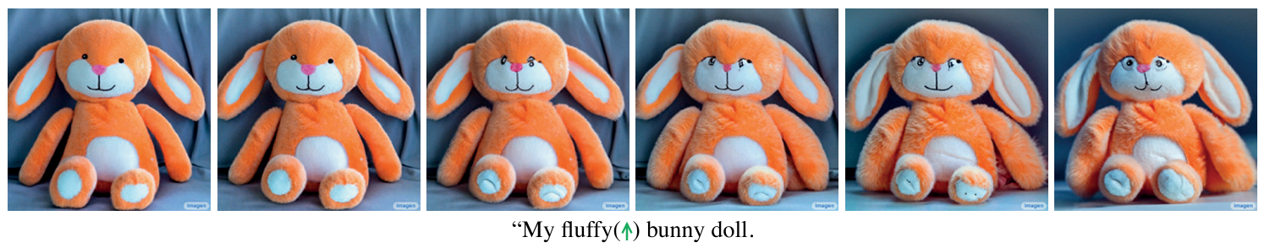
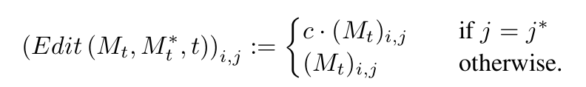
P2P
4.3 Attention Re–weighting
To amplify or attenuate the semantic effect of a word, simply re-weighting the corresponding attention map. The edit function is:
def replace_cross_attention(self, attn_base, att_replace):
if self.prev_controller is not None:
attn_base = self.prev_controller.replace_cross_attention(attn_base, att_replace)
attn_replace = attn_base[None, :, :, :] * self.equalizer[:, None, None, :]
# attn_replace = attn_replace / attn_replace.sum(-1, keepdims=True)
return attn_replace
self.equalizer: a vector to store the weight coefficient of each token, which is directly multiplied by the default attention map.
Chaining: self.prev_controller allows you to chain multiple controllers (e.g., replace first, then reweight) to achieve more complex editing combinations..
Effect: Does not change the original image structure, but the performance of a certain attribute is significantly strengthened or weakened→ suitable for fine-tuning image style or attribute intensity.
Notes:
The last operation is Attention Reweighting. We don't change words. We just change the attention strength of a word.
For example, to make a toy rabbit look more "fluffy", we multiply the attention map of the token "fluffy" by a parameter c. This can make the visual effect stronger or weaker.
In code, we use an equalizer vector to store the weight coefficient for each token, and directly multiply it with the default attention map.
Also, previous_controller allows to chain multiple controllers, like first do a replacement, then do reweighting – to achieve more complex editing combinations.
The result is that the structure is unchanged, but one certain feature is much stronger or weaker. This is perfect for fine-tuning image style or feature strength.
However, without an image inversion technique, this approach is limited to SYNTHESIZED images only.
For real-world photographs, its editing effect is not outstanding.
SO the Null-text Inversion is introduced.
Thank you!

Slide 20
03
Attention Storage Mechanism
Local Editing and Style Intensity Control
Notes:
In this project, we directly use the StableDiffusion Model without retraining or modifying the weights, achieving results only through interception and replacement.
Previously, my two teammates have explained the Null-Text Inversion concept, which ensures the original image can be replicated during generation, as well as the Prompt-to-Prompt concept, which intercepts the original attention data of the model and replaces it with the desired attention data to achieve "Modifying only the style, not the structure.“
Next, I will describe how local editing and style intensity control are implemented throughout the entire process.

Slide 21
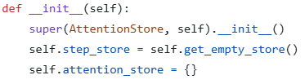

Attention
Storage
Local
Editing
Style
Intensity
Attention Storage Mechanism
Class AttentionStore, which is the prerequisite for all subsequent attention editing controllers. Components that play a role in the project later (such as LocalBlend for local protection ) must call the original attention heatmaps recorded in AttentionStore.
点击输入内容
点击输入内容
get_empty_store and the __init__ :
prepare for storing the original data
Three image processing stages:
downsampling (down), the middle layer (mid), and upsampling (up).
Two attention mechanism:
Cross-Attention (cross)——determines the relationship between image and text
Self-Attention (self)——determines the physical structure
Notes:
Before this, the attention storage mechanism is very important, specifically the most important class AttentionStore, which is the prerequisite for all subsequent attention editing controllers. Components that play a role in the project later(such as LocalBlend for local protection ) must call the original attention heatmaps recorded in AttentionStore.
The following are the most important functions in this section.
get_empty_store and the initialization function prepare for storing the original data. In the U-Net of Stable Diffusion, image processing is divided into three stages: downsampling (down), the middle layer (mid), and upsampling (up). Meanwhile, the attention mechanism is divided into cross-attention (cross), which determines the relationship between image and text, and self-attention (self), which determines the physical structure. Therefore, there are six categories here.

Slide 22
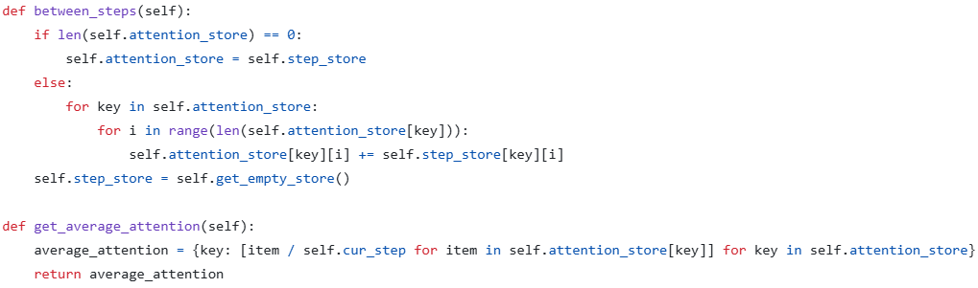
Attention
Storage
Local
Editing
Style
Intensity
Attention Storage Mechanism
The generation of a diffusion model is not achieved in a single step, but typically requires 50 denoising steps.
between_steps demonstrates how the data continues to be stored during the 50-step diffusion process.
Then, through get_average_attention, the accumulated data is divided by the total number of steps to obtain an average attention heatmap.
点击输入内容
点击输入内容
Notes:
We know that the generation of a diffusion model is not achieved in a single step, but typically requires 50 denoising steps. between_steps demonstrates how the data continues to be stored during the 50-step diffusion process. Then, through get_average_attention, the accumulated data is divided by the total number of steps to obtain an average attention heatmap.

Slide 23
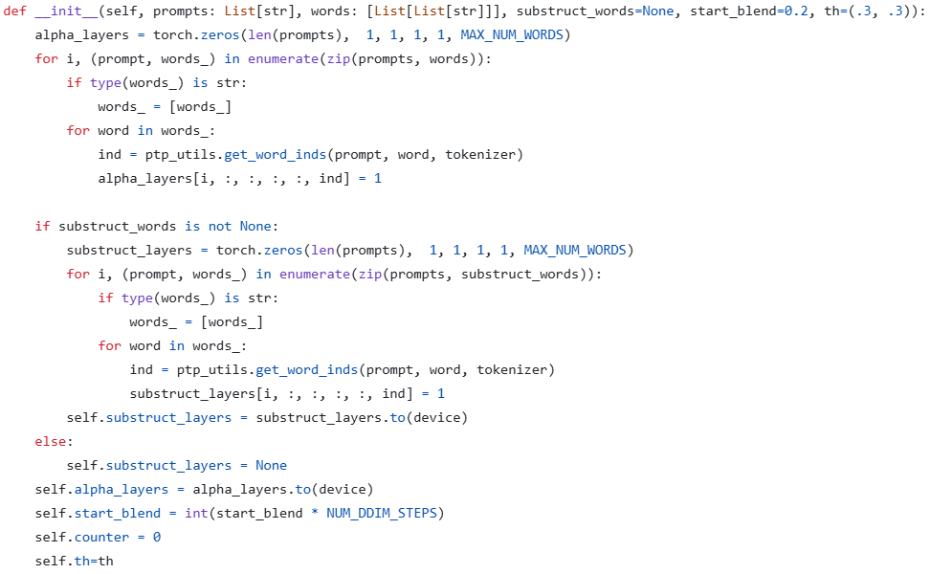
Attention
Storage
Local
Editing
Style
Intensity
Local Editing Module
Class LocalBlend:
Utilize the cross-attention priors spontaneously generated within the diffusion model to achieve local image editing, where only the semantic parts specified by the user are modified while the remaining regions remain unchanged.
This parameter is crucial for the subsequent process.
①
②
③
Notes:
The most important class is LocalBlend. Its function is to utilize the cross-attention priors spontaneously generated within the diffusion model to achieve local image editing, where only the semantic parts specified by the user are modified while the remaining regions remain unchanged.

Slide 24
Attention
Storage
Local
Editing
Style
Transfer
Local Editing Module
① ind = ptp_utils.get_word_inds(prompt, word, tokenizer)
The entire sentence, the target word, and the tokenizer are passed in. It returns the index position (ind) of the target word in the sentence.
Example:
If the target word to be edited is “woman” and the prompt is “A photo of a woman”.
After tokenization : [<start>, A, photo, of, a, woman, <end>].
The program finds that "woman" is at the 5th position, so ind returns 5.
② alpha_layers[i, :, :, :, :, ind] = 1
This performs tensor slicing and assignment, setting the value at the position we want to edit to 1. This prepares for the get_mask function to generate a mask.
Example:
"woman" is at the 5th position, so [0, 0, 0, 0, 0, 0, 0] is transformed into [0, 0, 0, 0, 0, 1, 0].
Notes:
First, it is necessary to know the position of the word to be modified and at which step to start intervening in the model. The initialization function performs these tasks:
ind = ptp_utils.get_word_inds(prompt, word, tokenizer): The entire sentence, the target word, and the tokenizer are passed in. It returns the index position (ind) of the target word in the sentence.
Example: If the target word to be edited is "woman" and the prompt is "A photo of a woman", after tokenization it becomes [<start>, A, photo, of, a, woman, <end>]. The program finds that "woman" is at the 5th position, so ind returns 5. This parameter is crucial for the subsequent process.
alpha_layers[i, :, :, :, :, ind] = 1: This performs tensor slicing and assignment, setting the value at the position we want to edit to 1. This prepares for the get_mask function to generate a mask.
Example: "woman" is at the 5th position, so [0, 0, 0, 0, 0, 0, 0] is transformed into [0, 0, 0, 0, 0, 1, 0].

Slide 25
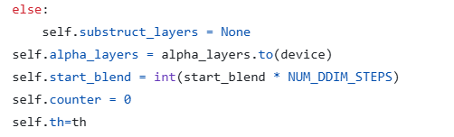
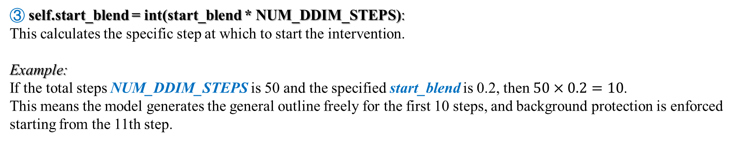
Attention
Storage
Local
Editing
Style
Intensity
Local Editing Module
③ self.start_blend = int(start_blend * NUM_DDIM_STEPS):
This calculates the specific step at which to start the intervention.
Example:
If the total steps NUM_DDIM_STEPS is 50 and the specified start_blend is 0.2, then $50×0.2=10$.
This means the model generates the general outline freely for the first 10 steps, and background protection is enforced starting from the 11th step.
Notes:
self.start_blend = int(start_blend * NUM_DDIM_STEPS): This calculates the specific step at which to start the intervention.
Example: If the total steps NUM_DDIM_STEPS is 50 and the specified start_blend is 0.2, then $50 \times 0.2 = 10$. This means the model generates the general outline freely for the first 10 steps, and background protection is enforced starting from the 11th step.

Slide 26
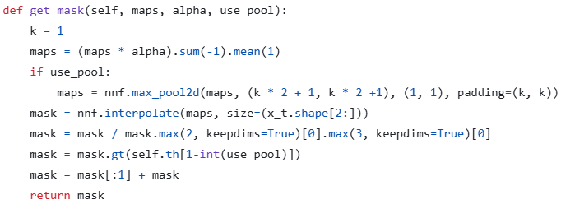
Attention
Storage
Local
Editing
Style
Intensity
Local Editing Module
get_mask
The most critical part for achieving local editing.
It receives high-dimensional "Cross-Attention Maps" from within the neural network and, through a series of mathematical calculations, converts them into a black-and-white 2D local protection mask.
During each image denoising step, it precisely blocks the features that would disrupt the background (occluded by the black mask) and only allows the style features acting on the target area to pass through.
Notes:
Next is the get_mask function, which is the most critical part for achieving local editing. It receives high-dimensional "Cross-Attention Maps" from within the neural network and, through a series of mathematical calculations, converts them into a black-and-white 2D local protection mask. During each image denoising step, it precisely blocks the features that would disrupt the background (occluded by the black mask) and only allows the style features acting on the target area to pass through.

Slide 27
Attention
Storage
Local
Editing
Style
Intensity
Local Editing Module
① maps = (maps * alpha).sum(-1).mean(1)
We obtained alpha from the __init__, and in this step, element-wise multiplication is performed. Except for the attention data of the word "woman," the attention of all other irrelevant words becomes 0. Then the originally complex tensor is transformed into a 2D base heatmap specifically for the target word.
② These four process the previously generated blurry, small, and numerically inconsistent heatmap into a standard mask with matching dimensions.
Finally, the pre-prepared mask is executed. During the 50 denoising steps of image generation, the system automatically calls this function after each step. It performs a local replacement of the current latent variable x_t at the tensor level, achieving text-driven local image protection.
Notes:
1. maps = (maps * alpha).sum(-1).mean(1)
We obtained alpha from the initialization function, and in this step, element-wise multiplication is performed. Except for the attention data of the word "woman," the attention of all other irrelevant words becomes 0. After this line of code executes, the originally complex tensor is transformed into a 2D base heatmap specifically for the target word.
2. The last four lines forcibly process the previously generated blurry, small, and numerically inconsistent heatmap into a standard mask with matching dimensions.
Finally, the pre-prepared mask is executed. During the 50 denoising steps of image generation, the system automatically calls this function after each step. It performs a local replacement of the current latent variable x_t at the tensor level, achieving text-driven local image protection.

Slide 28
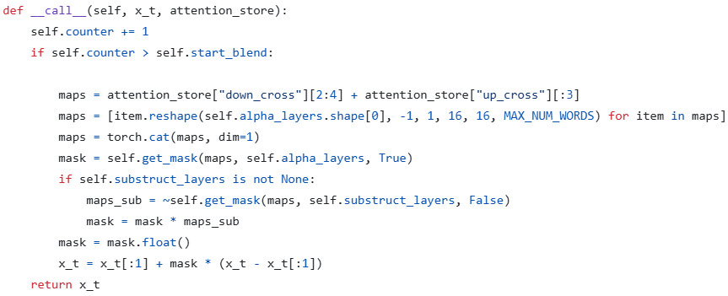
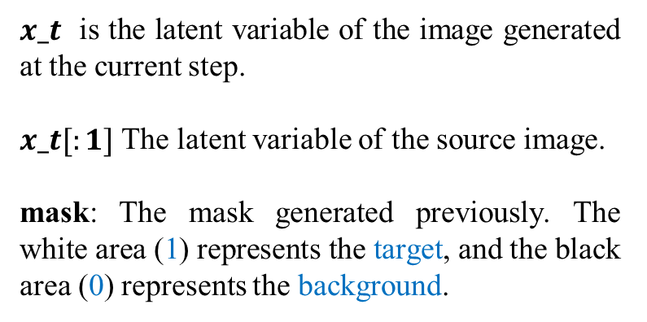
Attention
Storage
Local
Editing
Style
Intensity
Local Editing Module
__call__
Executes the previously prepared "target word switches" and "attention feature data." Through physical-level operations—masking and replacing at every step—it achieves text-driven local image protection at the tensor level.
$x_t$ is the latent variable of the image generated at the current step.
$x_t[:1]$ The latent variable of the source image.
mask: The mask generated previously. The white area (1) represents the target, and the black area (0) represents the background.
The black background portion is completely zeroed out and perfectly replaced by the actual pixels of the source image $x_t[:1]$ ; the white target portion is allowed to pass, retaining the newly generated style pixels.
Notes:
The __call__ function executes the previously prepared "target word switches" and "attention feature data." Through physical-level operations—masking and replacing at every step—it achieves text-driven local image protection at the tensor level.
$x_t$ is the latent variable of the image generated at the current step.
$x_t[:1]$: The latent variable of the source image.
mask: The mask generated previously. The white area (1) represents the target, and the black area (0) represents the background.

Slide 29
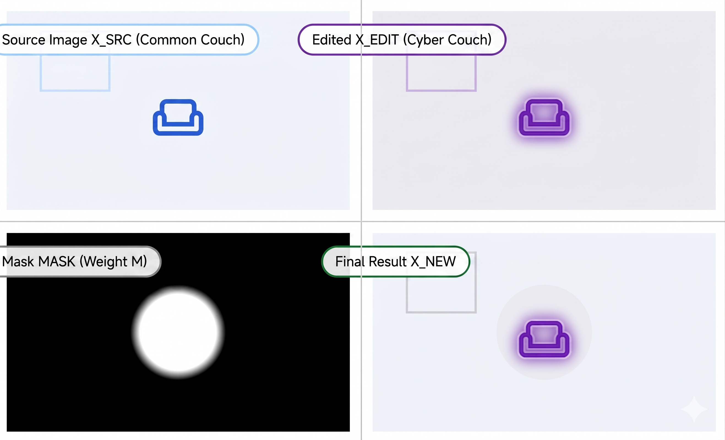
Attention
Storage
Local
Editing
Style
Intensity
Local Editing Module
The black background portion is completely zeroed out and perfectly replaced by the actual pixels of the source image $x_t[:1]$ ; the white target portion is allowed to pass, retaining the newly generated style pixels.
Notes:
The black background portion is completely zeroed out and perfectly replaced by the actual pixels of the source image $x_t[:1]$; the white target portion is allowed to pass, retaining the newly generated style pixels.

Slide 30
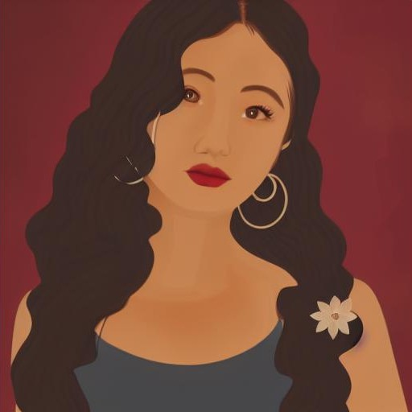
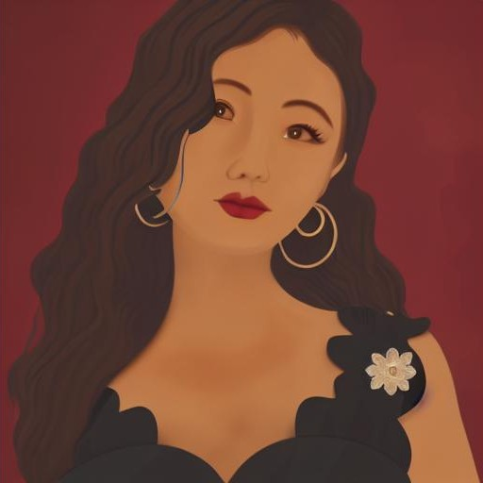
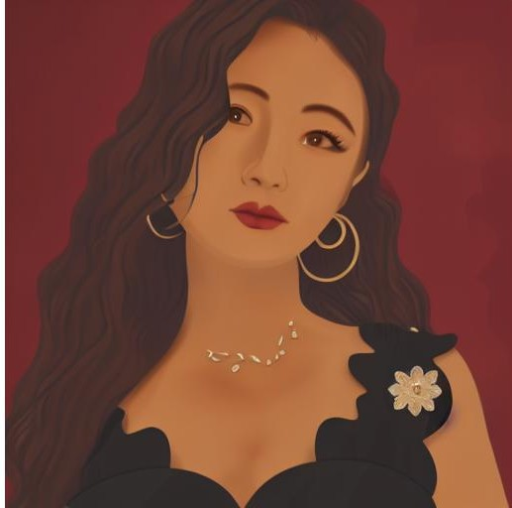
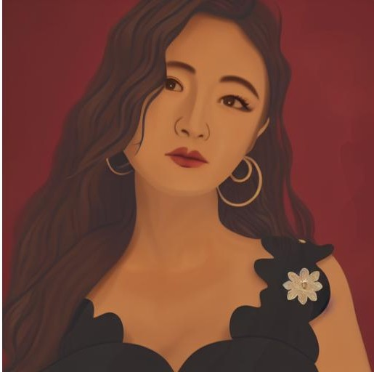
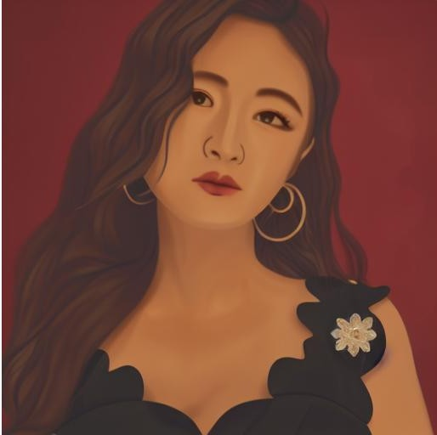
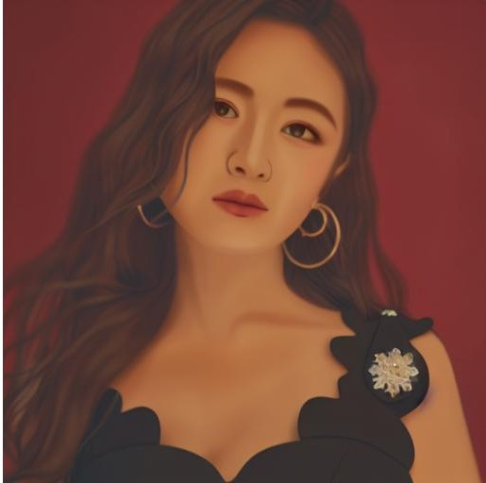
Attention
Storage
Local
Editing
Style
Intensity
Style Intensity
Style Intensity — Controlling the strength of structural preservation through the self_ratio parameter.
python cartoon_styles.py --description "A beautiful woman in curly long hair" --path example_images/LiLandi.jpg --blend woman --self_ratio 0.6
self_ratio is converted into the parameter self_replace_steps (Self-Attention replacement time steps). This is passed into the P2P framework, instructing the model to forcibly use the self-attention data of the original image during the first 60% of the time steps in the generation process, thereby strictly locking the physical structure of the person in the original image.
Notes:
The black background portion is completely zeroed out and perfectly replaced by the actual pixels of the source image $x_t[:1]$; the white target portion is allowed to pass, retaining the newly generated style pixels.

Slide 31
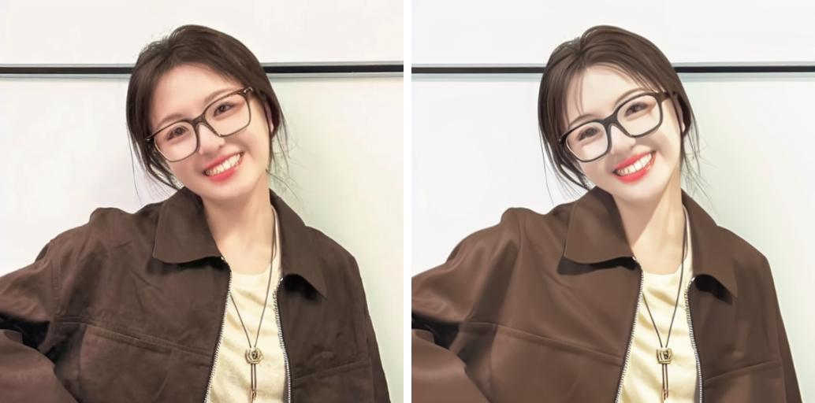
Background
& Significance
Methods
Methods
Results
Framework
Results

Slide 32
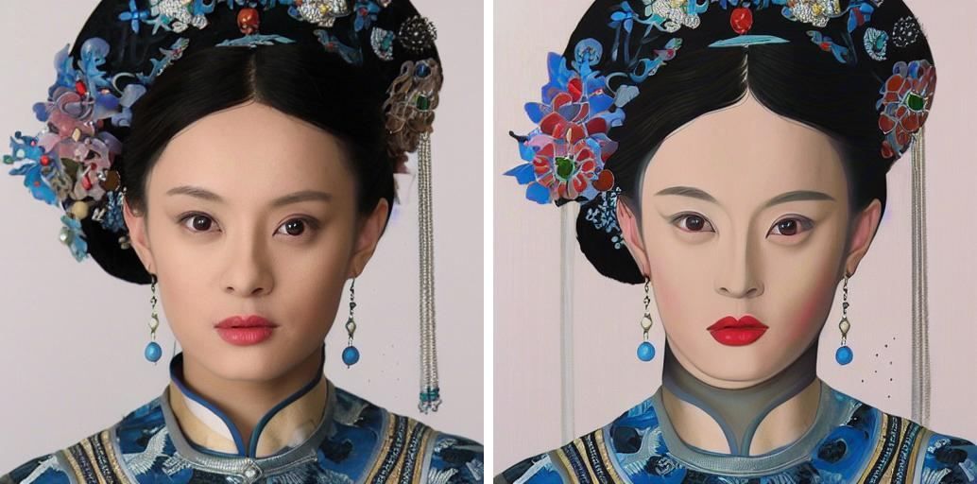
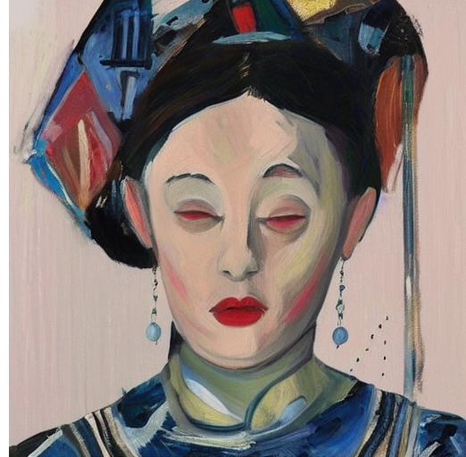
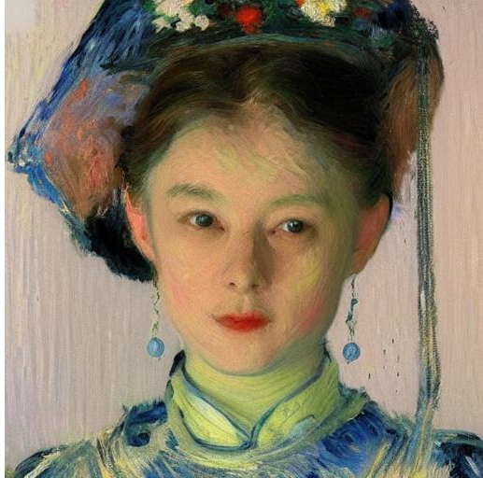
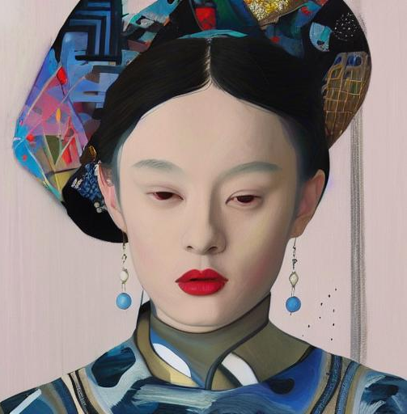
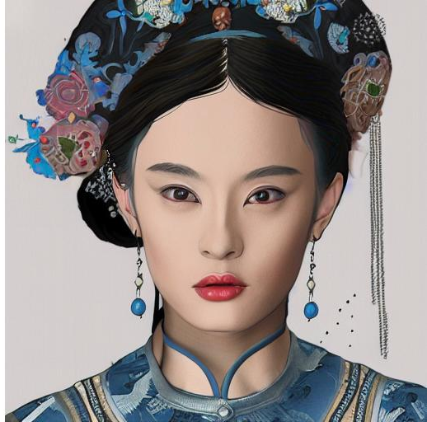
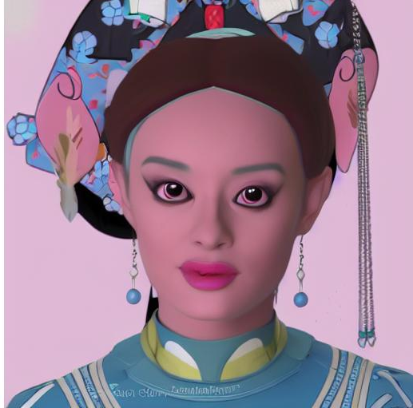
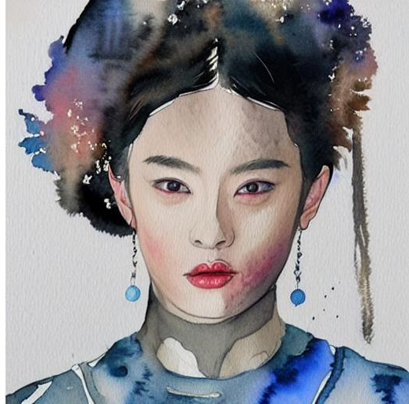
Background
& Significance
Framework
Methods
Results
Different styles with a self-ratio of 0.4
Input Image
Acrylic
Expressionism
Impressionism
Modern Art
Sketch
The Powerpuff Girl Cartoon
Watercolor

Slide 33
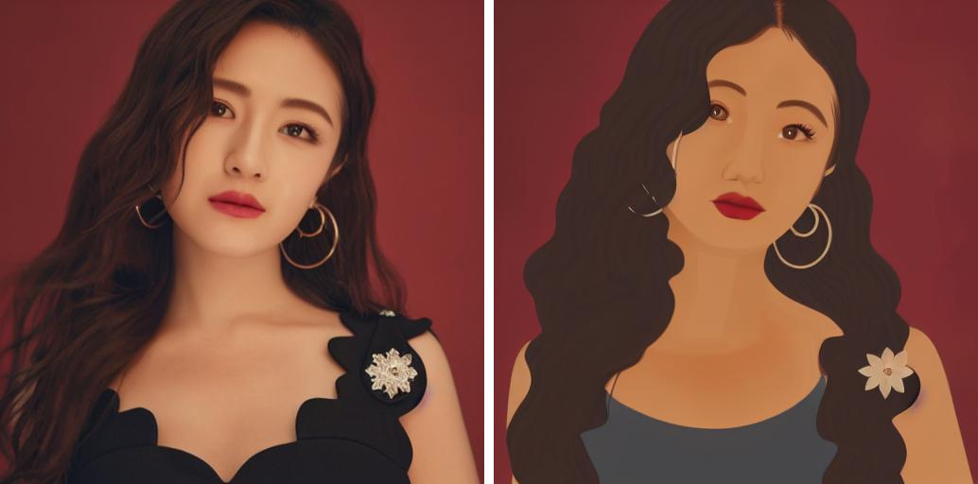
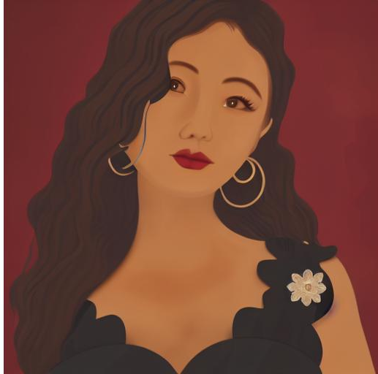
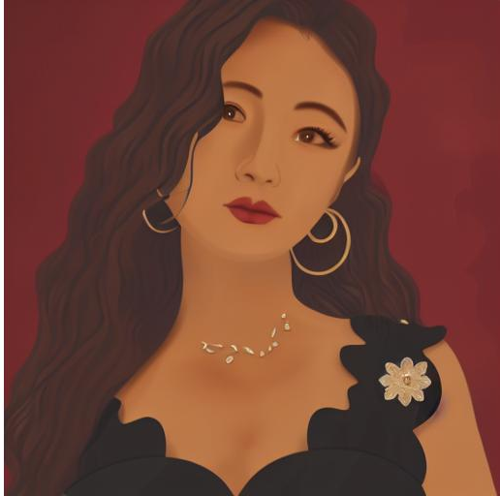




Background
& Significance
Framework
Methods
Results
Change the self_ratio of 0.2-0.8
Input Image
Sketch+0.2
Sketch+0.3
Sketch+0.4
Sketch+0.5
Sketch+0.6
Sketch+0.7
Sketch+0.8

Slide 34







Background
& Significance
Framework
Methods
Results
Change the self_ratio of 0.2-0.8
Input Image
Expressionism+0.2
Expressionism+0.3
Expressionism+0.4
Expressionism+0.5
Expressionism+0.6
Expressionism+0.7
Expressionism+0.8

Slide 35







Background
& Significance
Framework
Methods
Results
Change the self_ratio of 0.2-0.8
Input Image
Impressionism+0.2
Impressionism+0.3
Impressionism+0.4
Impressionism+0.5
Impressionism+0.6
Impressionism+0.7
Impressionism+0.8

Slide 36
Reference
[1] Prompt-to-Prompt Image Editing with Cross-Attention Control, A. Hertz et al., ICLR 2023
[2] Null-text Inversion for Editing Real Images using Guided Diffusion Models, R. Mokady et al., CVPR 2023
[3] Learning Transferable Visual Models From Natural Language Supervision, A. Radford et al., ICML 2021
[4] Denoising Diffusion Implicit Models, J. Song et al., ICLR 2021
[5] Denoising Diffusion Probabilistic Models, J. Ho et al., NeurIPS 2020
[6] High-Resolution Image Synthesis with Latent Diffusion Models, R. Rombach et al., CVPR 2022
[7] Guided Image Synthesis and Editing with Stochastic Differential Equations, C. Meng et al., ICLR 2022
[8] An Edit Friendly DDIM Inversion for Generating High-Resolution Images, M. Panashchuk et al., arXiv 2023

Slide 37
THANK YOU
Zhang Xiting, Guo Jiawei, Wang Xiaoye, Lu Siyuan
2026.5.5

